Slide 2
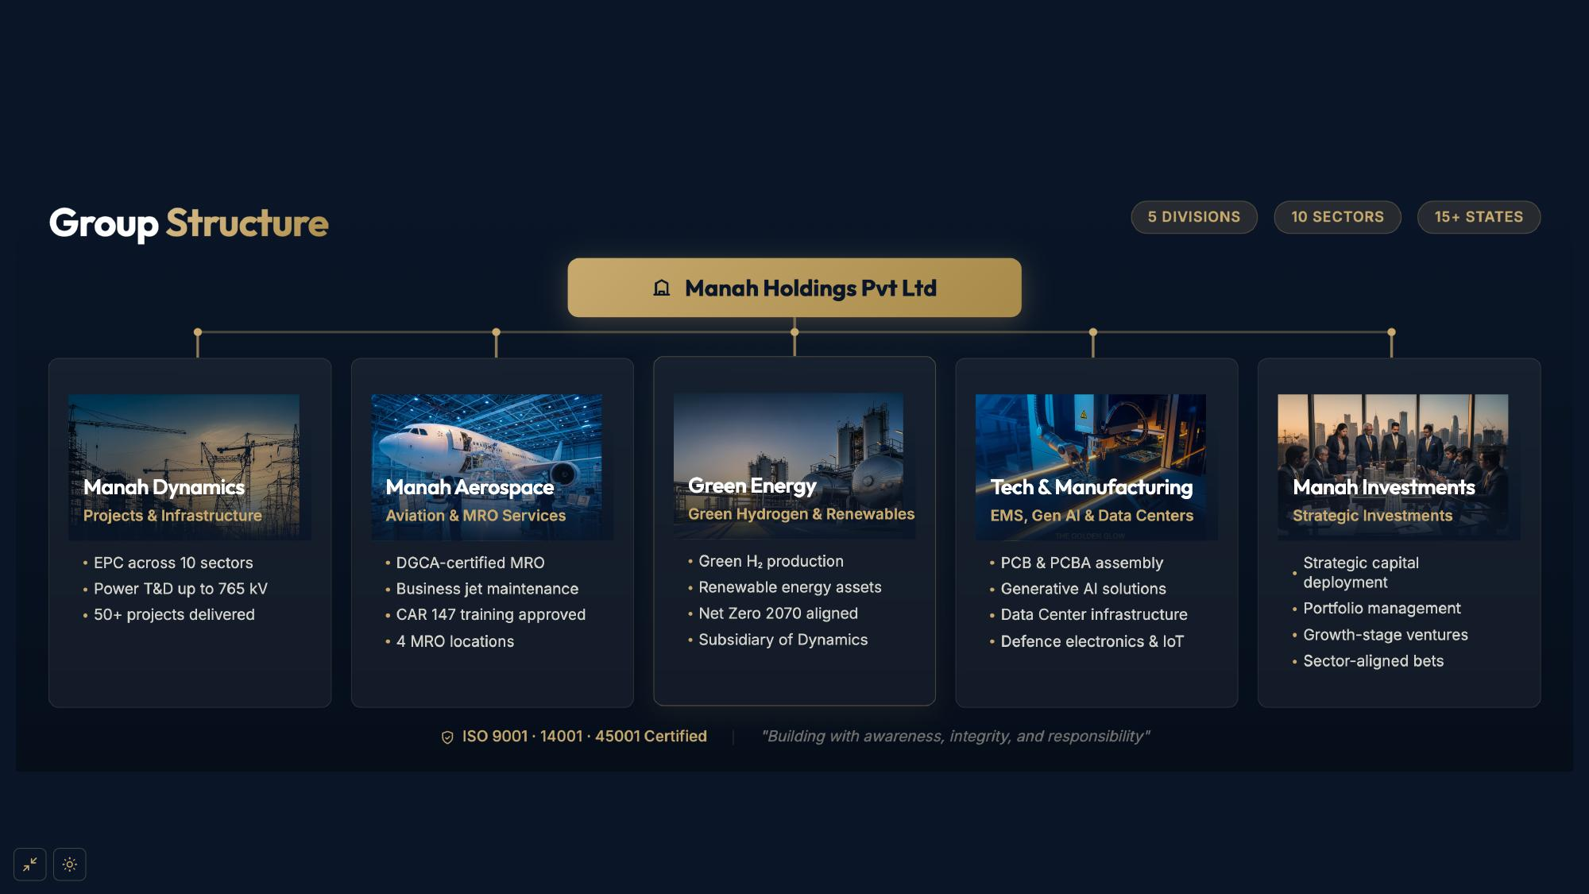
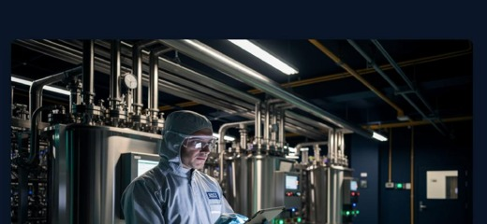
Manah Atomic
Nuclear Energy Solutions
• Small Modular Reactors (SMR)
• Advanced nuclear fuel cycle
• Reactor safety & compliance
• Clean energy transition

Slide 3


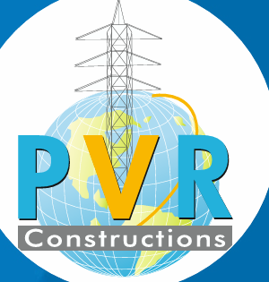

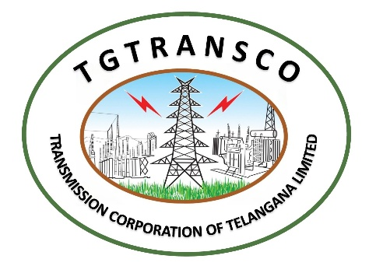


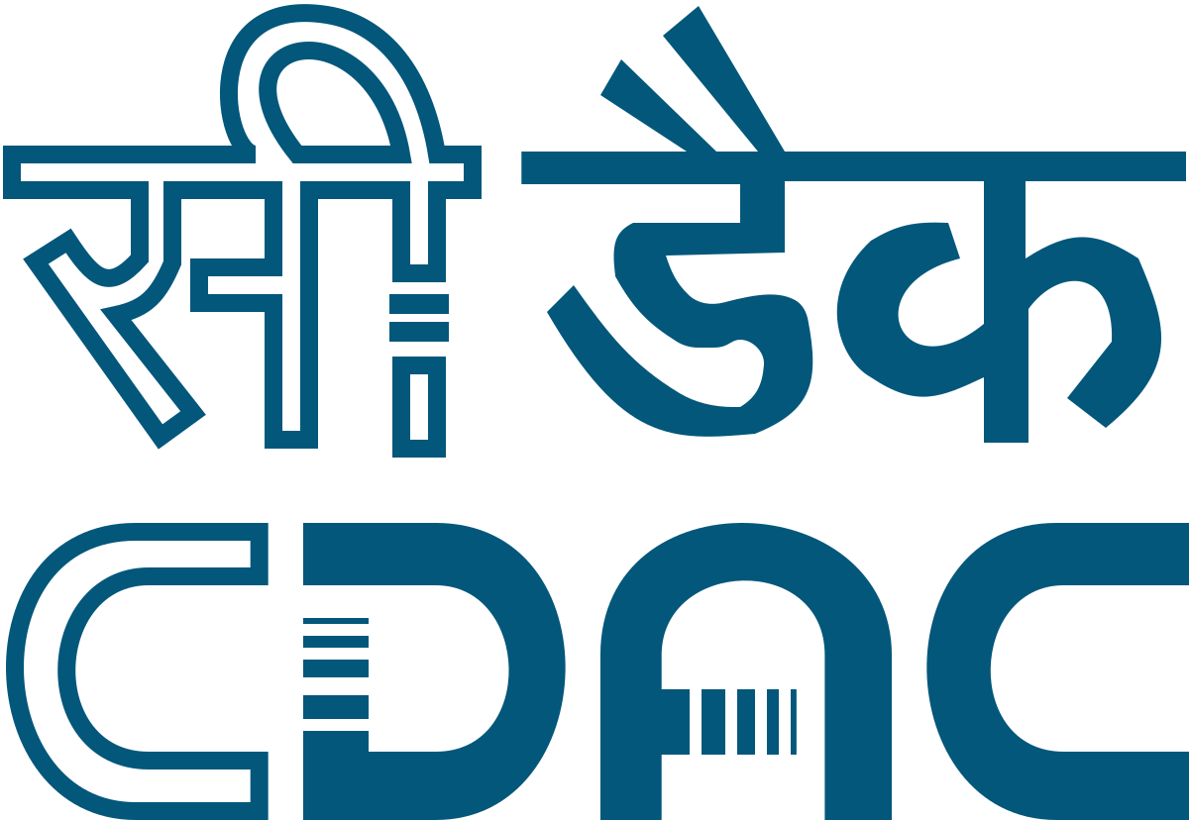







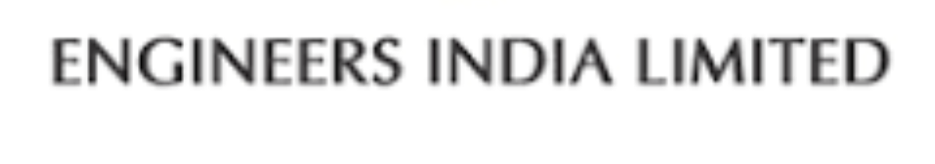


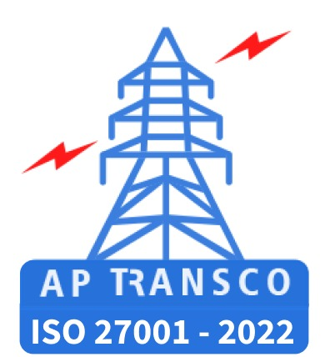







Strategic partnerships

Slide 4

PROJECT PORTFOLIO OVERVIEW
Ongoing: ₹2200 Cr
Pipeline: ₹20,000+ Cr
SOME OF ONGOING PROJECTS
# | Project | Client | Sector
1 | Construction of Four G+4 Residential Buildings | MES | Civil
2 | Supply & Installation of 48,893 DTC Meters (6 Districts) + 5-Yr Maintenance | HESCOM | Power / Metering
3 | Construction of 400/220 KV GIS Substation | PGCIL, Roorkee | Power Transmission
4 | Construction of Transmission Line & Towers - 400/220 KV GIS Substation | PGCIL, Roorkee | Power Transmission
5 | Construction of Conveyor system | Morocco | Industrial Infra
6 | Construction & Development of Commercial complex | Singrauli, MP | Real Estate
7 | Development of Middle Mile Network on DBOM Basis | BharatNet | Telecom / Infra
8 | Construction G+17 Building in Mumbai | Terna Trust | Civil
9 | Construction of G+2 Building in ahilyanagar | MES | Civil
10 | Construction of 5G Towers in 6 states | BSNL | Telecom / Infra
11 | Construction of Ambhaji Railway Station | NWR | Civil

Slide 5
PROJECT PORTFOLIO OVERVIEW
Ongoing: ₹2000 Cr
Pipeline: ₹20,000+ Cr
PIPELINE PROJECTS
# | Category | Description | Status
1 | M&A | Due Diligence of Product & EPC Companies for 3 Potential Mergers & Acquisitions | Strategic
2 | EPC Bids | EPC Works Being Pursued via Bids in Domestic & International Markets | Active Bidding
3 | Investments | Investments Under Planning & Execution Across Key Infrastructure Sectors | Under Planning
4 | HAM Projects | Hybrid Annuity Model Projects Under Bidding at Domestic Level | Under Bidding
₹5,500 Cr
₹8,000 Cr
₹6,500 Cr
3 Deals
EPC Bids
Investments
HAM Projects
M&A Targets
Combined Pipeline Opportunity: ₹20,000+ Crores | Domestic & International Markets

Slide 6
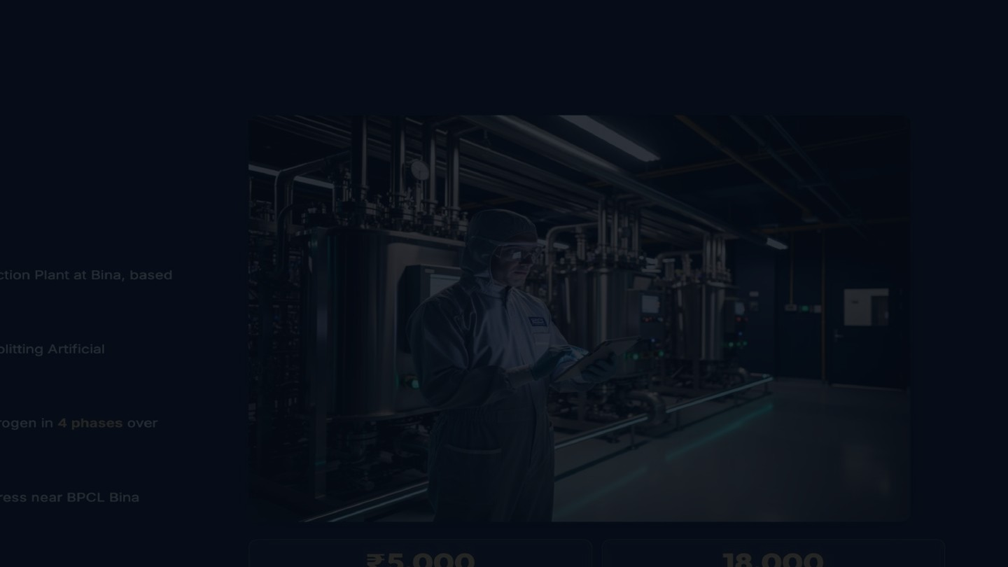
DIVISION 4 OF 5
Manah Atomic Private Limited
"Pioneering Clean Nuclear Energy for a Sustainable Tomorrow"
Manah Atomic Private Limited is building India's next-generation nuclear energy platform — deploying Small Modular Reactors (SMRs) and advanced reactor technologies
to deliver safe, scalable, and carbon-free power for industrial clusters, remote grids, and national energy security.
SMR
100 GW
100+ MW
₹10,000
Technology Focus
Targeted by 2047
Per Reactor Unit
Cr Investment Plan
Small Modular Reactors
India's Clean Energy Path
Scalable Output Capacity
Phased Capital Deployment
Small Modular Reactors (SMR)
Nuclear Fuel & Waste Management
R&D & Technology Licensing
Factory-built, deployable reactors of 50–300 MW. Faster to construct, lower capital risk, and scalable for industrial clusters, remote grids & defence installations across India.
End-to-end fuel cycle management — procurement, processing, and safe disposal — in compliance with IAEA and AERB standards, ensuring zero-compromise safety.
Advanced passive safety systems, global nuclear lab partnerships, and reactor technology licensing to accelerate India-first SMR deployment with proven international standards.

